Slide 1



HACK SESSION
Keeping Eyes on Your Agents​
SPEAKER
Dr. Aditya Bhattacharya
Applied AI Lead, Nutanix
August 05–08, 2026 · The Leela Bhartiya City, Bengaluru
Human × AI

Slide 2


SCAN THIS QR CODE
Scan to access session resources
All files for today’s session in one place
Datasets and sample files
Presentation deck
Code files and notebooks
Reference links and guides
D A T A H A C K S U M M I T 2 0 2 6

Slide 3
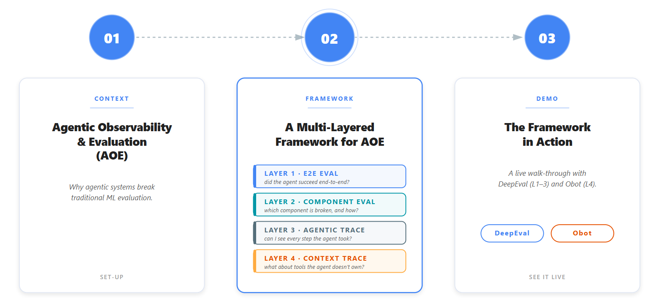
Agenda
D A T A H A C K S U M M I T 2 0 2 6

Slide 4

01
CONTEXT
Agent Observability & Evaluation (AOE)​
Why agentic systems break traditional ML evaluation.
August 05–08, 2026 · The Leela Bhartiya City, Bengaluru
Human × AI

Slide 5
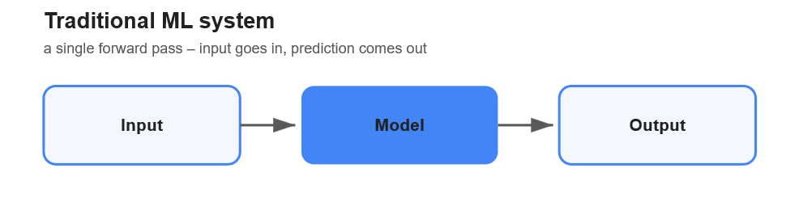
Agent Observability & Evaluation (AOE)​
Why is AOE more challenging than traditional ML systems?
A traditional ML system has a single hop: input → model → output. ​
Systems that plan, act and verify across multi-step workflows, humans in the loop.
D A T A H A C K S U M M I T 2 0 2 6

Slide 6
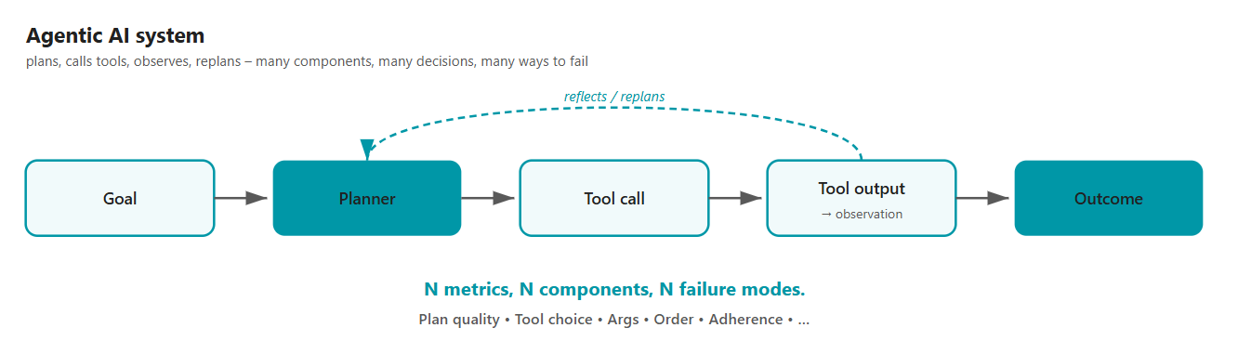
Agent Observability & Evaluation (AOE)​
Why is AOE more challenging than traditional ML systems?
An agentic system runs a trajectory: multiple LLM calls, tool calls, retries, and branches for producing an output.
It has N components → N failure modes
D A T A H A C K S U M M I T 2 0 2 6

Slide 7
Agent Observability & Evaluation (AOE)
Why this breaks traditional evaluation?
End-to-end metrics show failure without reasoning​ For example, task success rate dropped from 78% to 64% >> gives nothing actionable.
Component-only metrics miss emergent behaviour. E.g., a tool that is individually 95% accurate can still cause cascade failures when chained together in a workflow.​
Without a runtime visibility, debugging becomes a nightmare. By the time the user complains, the trace is gone, the LLM is non-deterministic, and we cannot reproduce the failure.​
D A T A H A C K S U M M I T 2 0 2 6

Slide 8
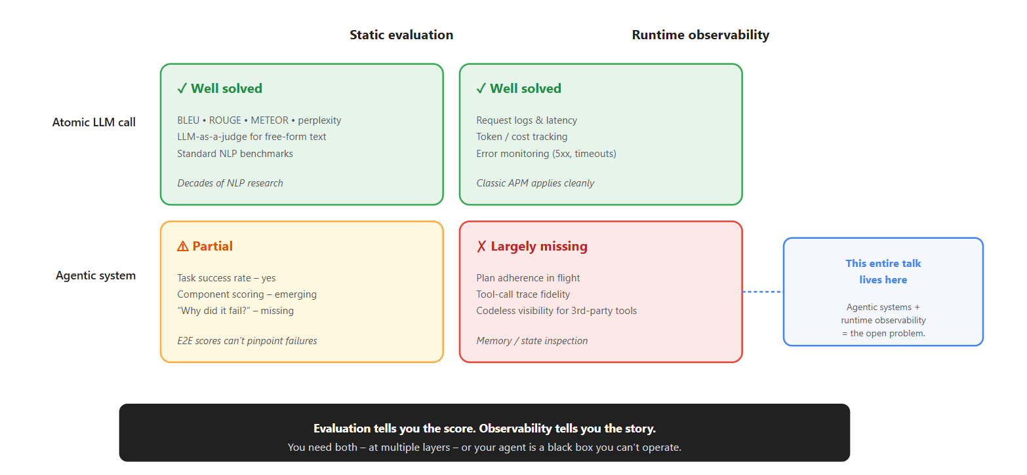
Agent Observability & Evaluation (AOE)
AOE matrix for traditional ML vs Agentic Systems
D A T A H A C K S U M M I T 2 0 2 6

Slide 9
Agent Observability & Evaluation (AOE)
AOE matrix for traditional ML vs Agentic Systems
D A T A H A C K S U M M I T 2 0 2 6

Slide 10
02
FRAMEWORK
A Multi-Layered Framework for AOE
August 05–08, 2026 · The Leela Bhartiya City, Bengaluru
Human × AI

Slide 11
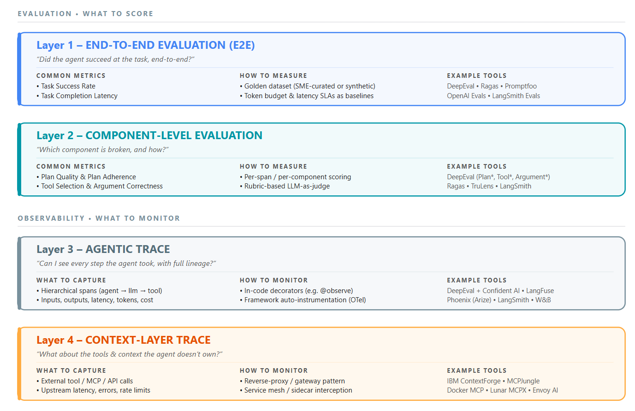
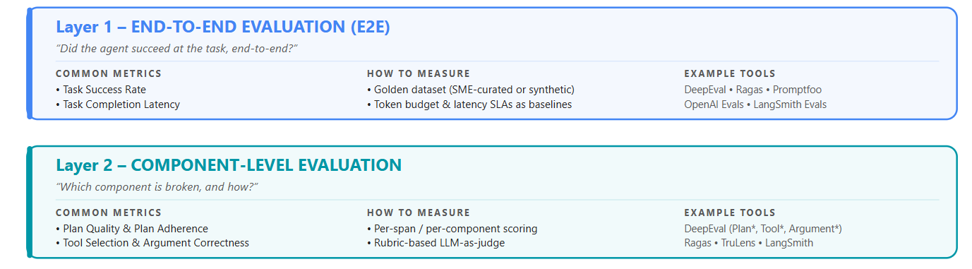
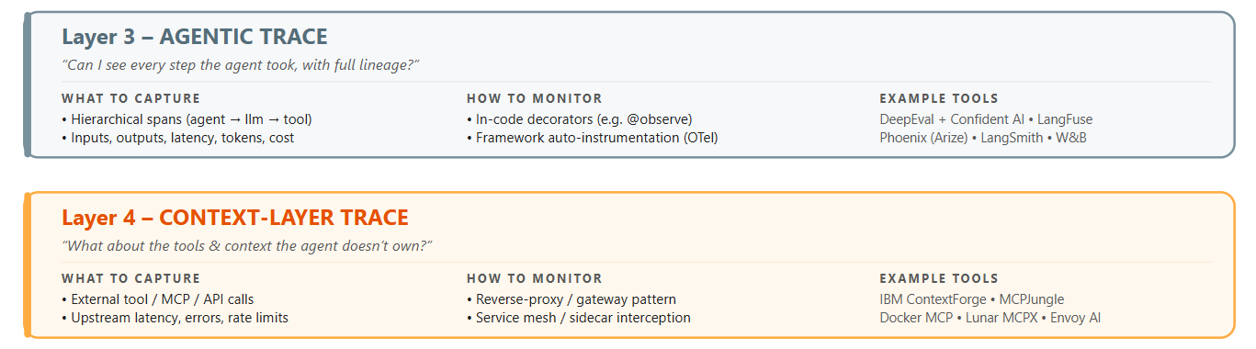
A Multi-Layered Framework
D A T A H A C K S U M M I T 2 0 2 6
Notes:
Two stacks, four layers. The top stack is what to evaluate, organized by scope. The bottom stack is what to monitor, defines what to keep an eye on.

Slide 12
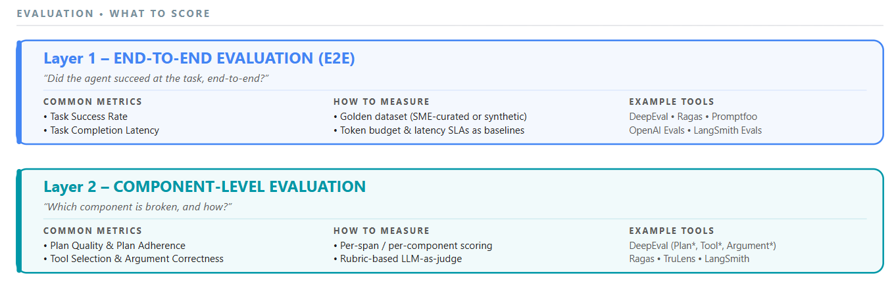
Stack 1: Evaluation Layers
Layer 1 gives the macro view of the agentic system for overall evaluation. E.g., A travel-planning agent is evaluated on both the quality of the itinerary and its ability to successfully complete bookings.
Layer 2 gives the micro view of the system that tells us how good the agentic system is in terms of planning, reasoning and execution. A travel-planning agent is evaluated on whether it selected the right tools, followed the user prompts correctly, and made the bookings correctly with the right specifications.
D A T A H A C K S U M M I T 2 0 2 6

Slide 13
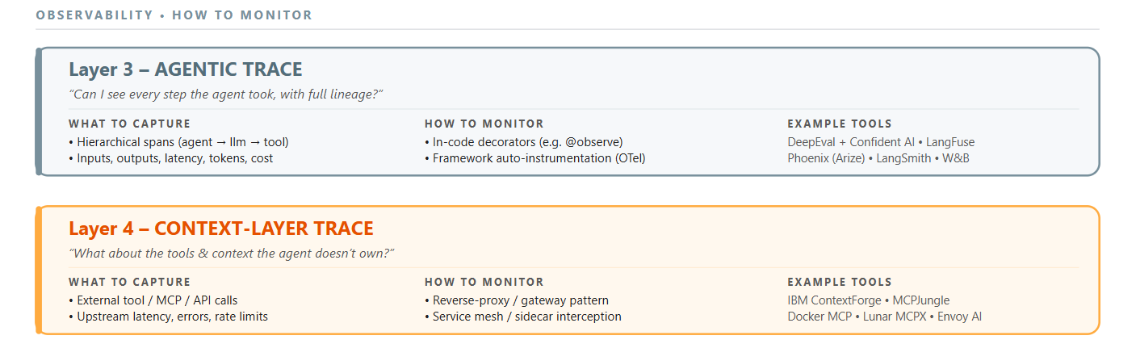
Stack 2: Observability Layers
Layer 3 is about tracing each step of the agent. E.g., Checking if the travel agents called the right tools in the right order
Layer 4 gives visibility around what is coming and going to remote MCP servers. This is essential for context management E.g., Tracking if the travel agents send the right passenger details when calling the reservation tool.
D A T A H A C K S U M M I T 2 0 2 6

Slide 14
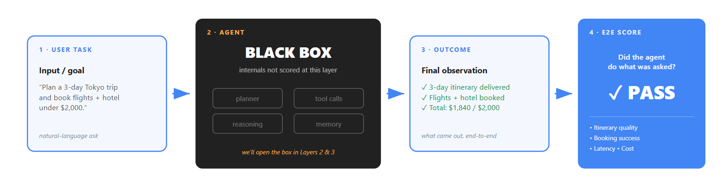
Layer 1: E2E Eval
What is End-to-End Evaluation?
The idea is to treat the agent as a black box and score the outcome, not the internals.
One input → one final observation: Did the agent do what was asked?
The closest proxy to user-perceived success.
D A T A H A C K S U M M I T 2 0 2 6
Notes:
Before we open the box and look at planning, tool calls, memory, and all the moving parts inside an agent, we need a single number that says "this thing works." That's what E2E evaluation is. You hand the agent a task, you let it run free, and at the end you ask one question: did it succeed? Everything else — component scores, traces, observability — is in service of explaining why this top-line number moved.

Slide 15
Layer 1: E2E Eval
Why E2E Evaluation Matters?
Captures emergent behaviour. Every component can be "fine" and the system still broken.
Aligns to product, not pipeline. Maps directly to a business outcome the team can rally around.
The only fair way to compare agents. Different architectures, different components — same task, same verdict.
Task regression net. Any change anywhere in the stack shows up here first.
The baseline that justifies everything else. Without it, lower-layer metrics are local optima with no anchor.
D A T A H A C K S U M M I T 2 0 2 6
Notes:
Here's the failure mode I want you to avoid: a team that has gorgeous component-level dashboards, every tool call is 98% correct, every plan scores 0.9 on quality — and the agent still ships broken. Because the parts work, but the system doesn't. E2E is what catches that. It's also the only metric your PM, your CEO, and your on-call engineer will all care about. It's the keystone.

Slide 16
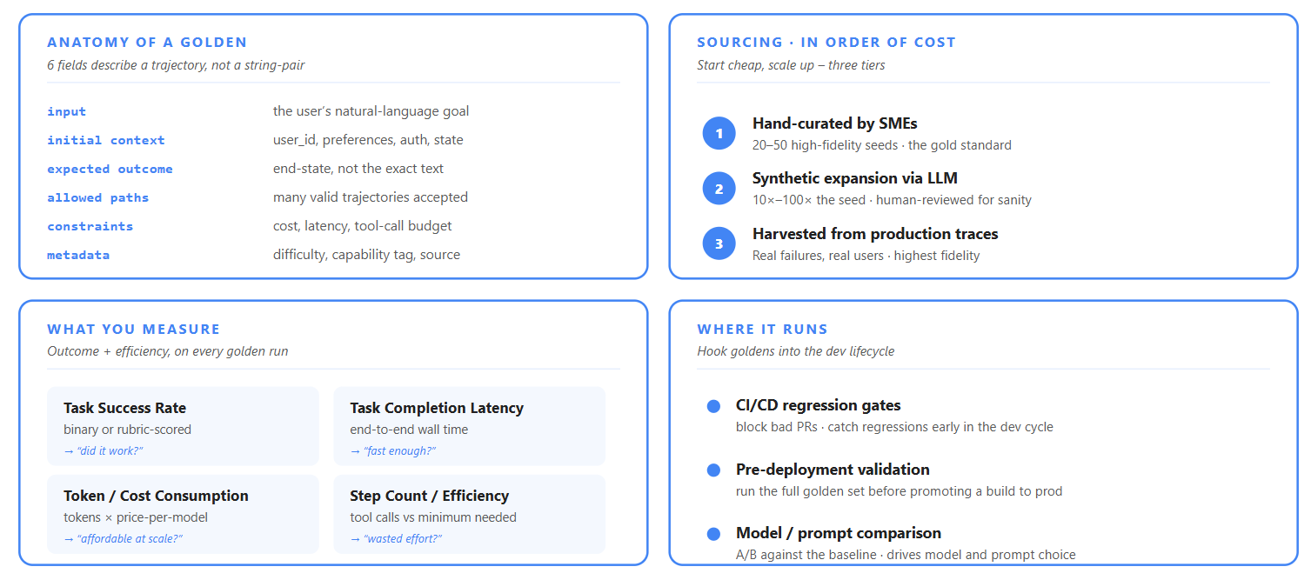
Layer 1: E2E Eval
Offline Eval with Golden Datasets
D A T A H A C K S U M M I T 2 0 2 6
Notes:
The golden dataset is the cornerstone artefact of Layer 1. Treat it like a product — version it, review it, grow it. Start with 20 hand-written cases from domain experts on day one. Generate 200 synthetic variants in week two. Wire production failures back into it every sprint. The trap people fall into is treating goldens like LLM goldens — input/output text pairs. Agent goldens are trajectory-shaped: you describe the goal and the constraints, not the exact answer, because there are usually many valid ways to succeed.

Slide 17
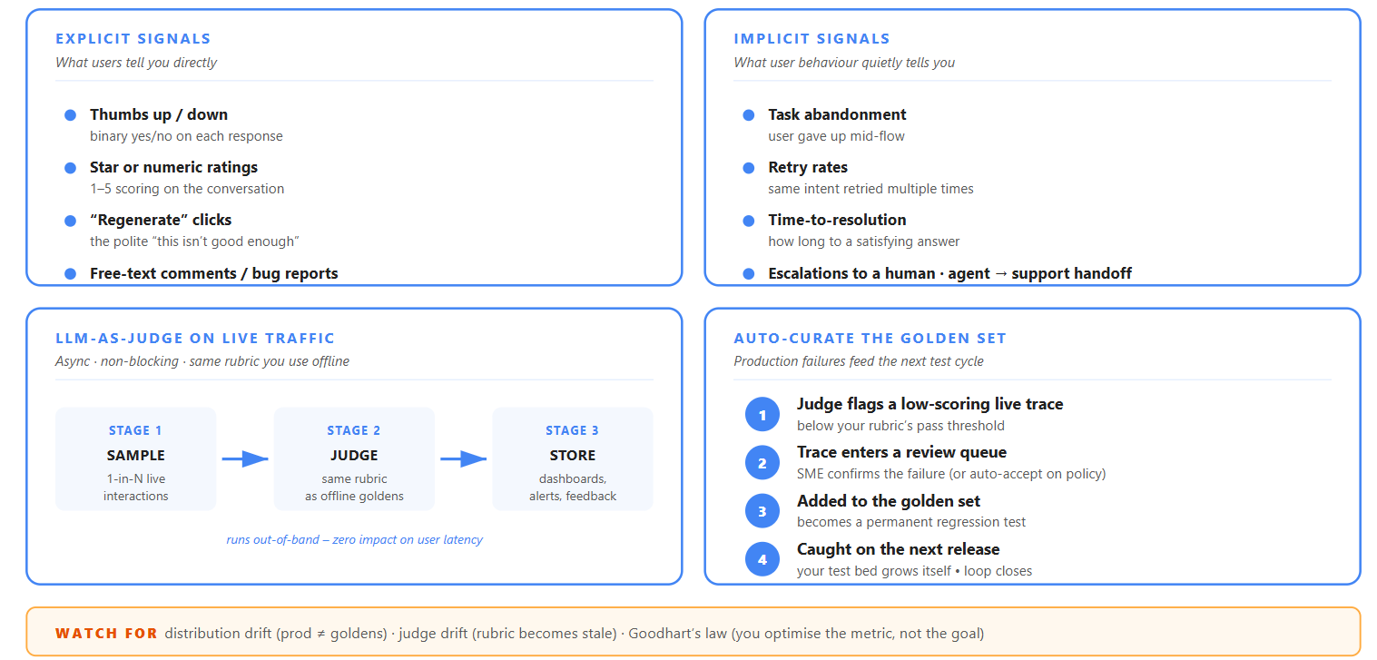
Layer 1: E2E Eval
Online Eval in Production
Notes:
Offline golden dataset give you a stable yardstick. Production gives you the truth. Both are necessary. A golden dataset run can be at 95% success in CI and the agent can still be failing 30% of the time in prod because user inputs look nothing like your test set. Online eval closes that loop. The most powerful pattern I've seen is auto-curation: every time the live judge scores below a threshold, the trace goes into a review queue, gets relabelled by a human, and joins the golden set. Within a quarter your test bed reflects reality, not your assumptions.

Slide 18
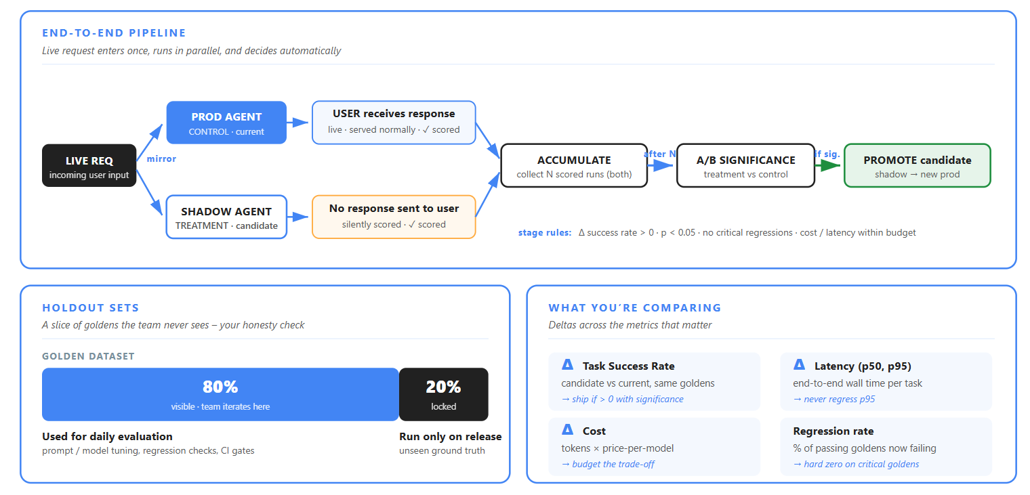
Layer 1: E2E Eval
A/B Testing & Shadow Deploys
D A T A H A C K S U M M I T 2 0 2 6
Notes:
Mirror live traffic, score both in parallel, promote the candidate when it’s statistically better. Shadow deploys and A/B tests are the bridge between "passes in CI" and "owns the production traffic." They let you make changes — to a prompt, a model, an architecture — and see the effect on the only metric that matters, before the user feels it.

Slide 19
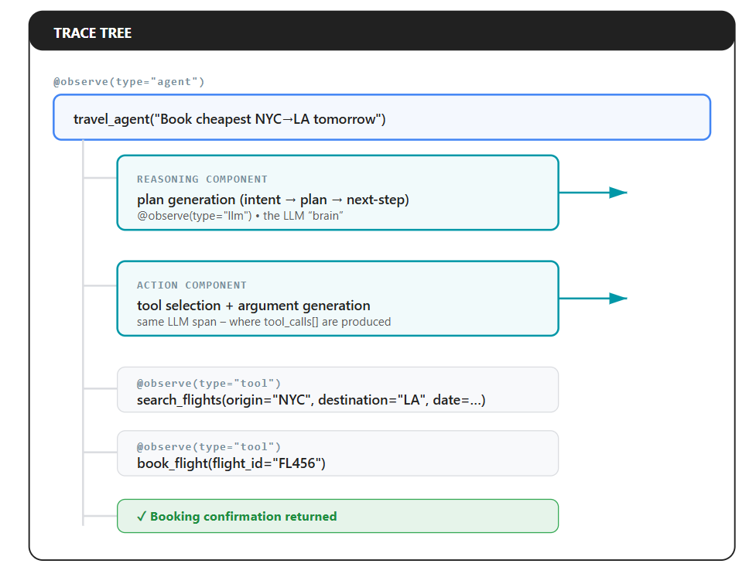
Layer 2: Component Level Eval
Isn’t E2E eval enough?
End-to-end metrics tell us that something failed; component metrics tell us were.
Without Layer 2, debugging an agent failure is an uphill task
Teams spend hours staring at a trace trying to figure out whether the problem was a bad plan, a wrong tool, or a wrong argument.
D A T A H A C K S U M M I T 2 0 2 6

Slide 20
Layer 2: Component Level Eval
Why is it important?
Debugging: Identify where and why the agent failed
Observability: Understand reasoning, tool usage, latency, and cost
Optimization: Detect redundant calls, inefficient planning, and context bloating
Evaluation: Correlate agent behavior with task success/failure
Production Reliability: Enable proactive monitoring and retrospective analysis
D A T A H A C K S U M M I T 2 0 2 6

Slide 21
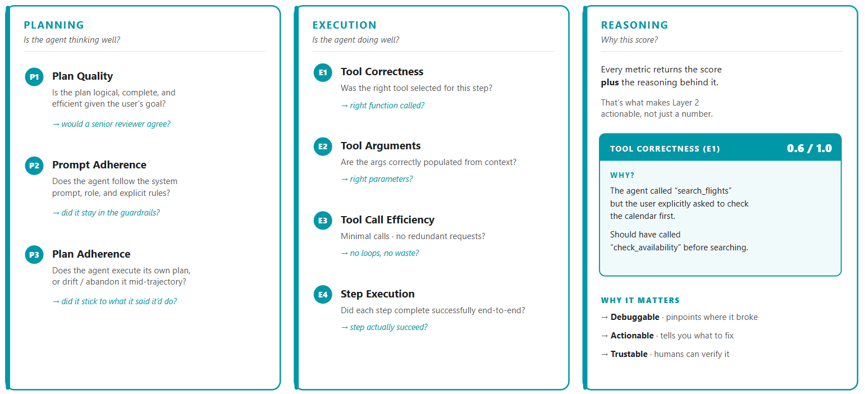
Layer 2: Component Level Eval
What to evaluate?

Slide 22
Layer 2: Component Level Eval
Common failure modes in agents
Failure Modes | Symptom
Wrong tool | Task fails silently, weird answer
Wrong argument | API errors / nonsense results
Wrong order | Dependency violations
Redundant calls | Burned $$$, latency spikes
Missing calls | Incomplete answers
D A T A H A C K S U M M I T 2 0 2 6

Slide 23
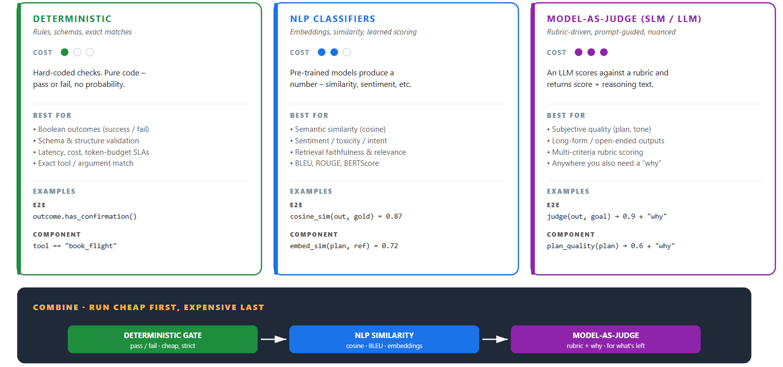
Stack 1: Eval Methods

Slide 24
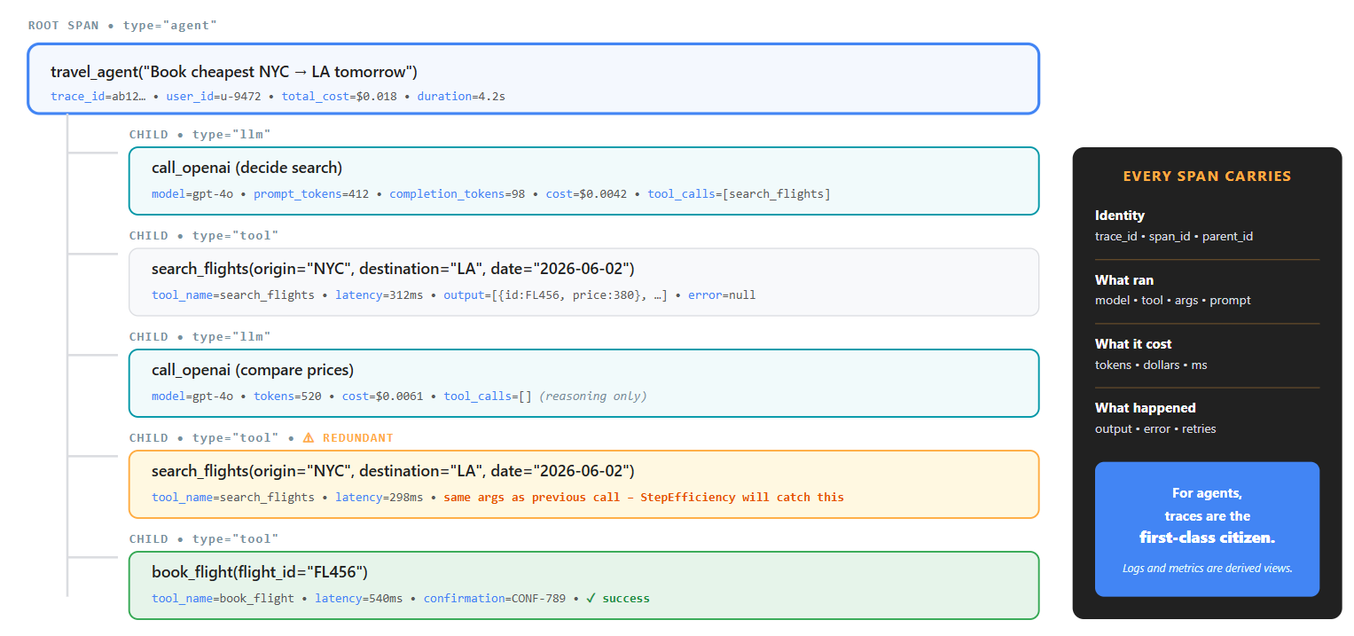
Layer 3: Agentic Trace
Agentic trace is the entire execution lineage of an AI agent that captures:
every reasoning step,
tool call,
decision,
input/output,
latency,
token usage,
failure across the workflow
D A T A H A C K S U M M I T 2 0 2 6

Slide 25
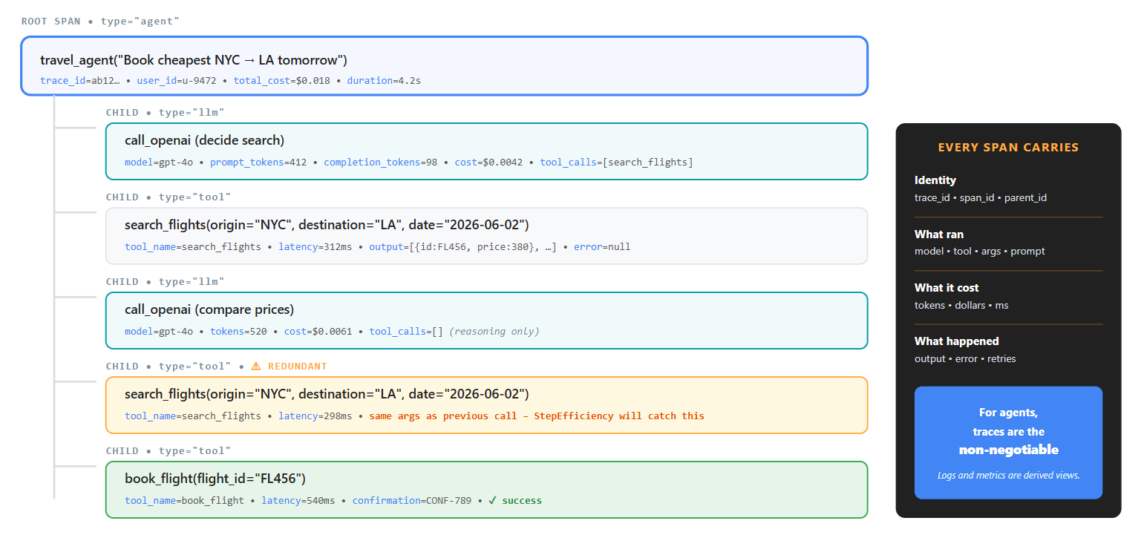
Layer 3: Agentic Trace
D A T A H A C K S U M M I T 2 0 2 6

Slide 26
Layer 3: Agentic Trace
Three Pillars of Agentic Trace
Pillar | Best for | For agents?
Logs | Human-readable text | ⚠ Hard to correlate
Metrics | Aggregates, alerts | ⚠ Lose causality
Trace | Causal Trees | ✅ Non-negotiable
For agents, traces are primarily important. Logs and metrics are derived views.
D A T A H A C K S U M M I T 2 0 2 6

Slide 27
Layer 3: Agentic Trace
Components of Agentic Trace:
Identity: trace_id, span_id, parent_span_id
What ran: model name, tool name, prompt, args
What it costs: tokens, dollars, milliseconds
What happened: output, error, retry count
D A T A H A C K S U M M I T 2 0 2 6

Slide 28
Layer 4: Context Layer Trace
How is it different from Agentic trace?
Agentic trace is an instrumentation approach: to obtain the lineage code, changes are required
Agentic systems often depend on remote third party MCP servers for run-time context. This requires codeless observability.
Compliance / EU AI Act audit requirements demand traceability for every tool call, not just the ones instrumented.
Context layer trace is achieved using MCP gateways that operate on reverse-proxy servers.
D A T A H A C K S U M M I T 2 0 2 6

Slide 29
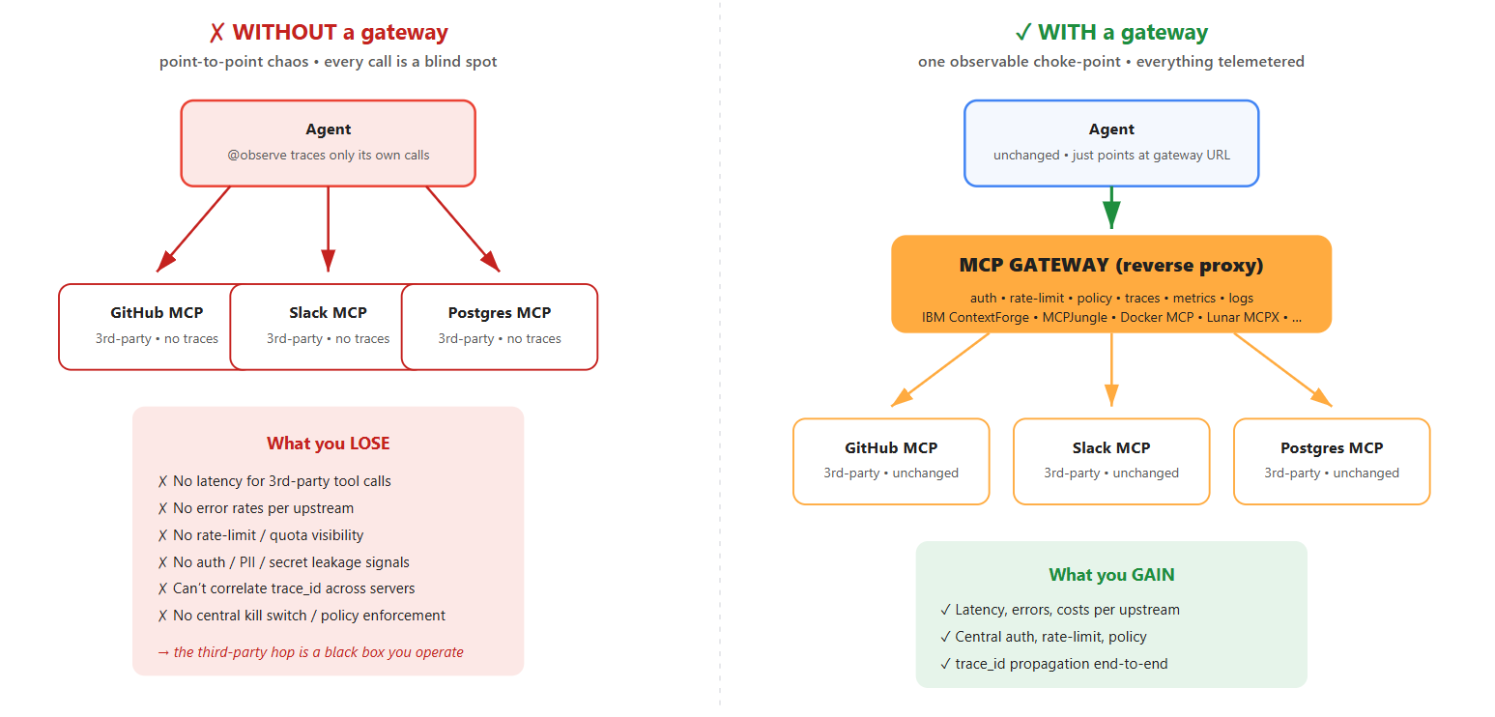
Layer 4: Context Layer Trace
MCP Gateways
D A T A H A C K S U M M I T 2 0 2 6

Slide 30
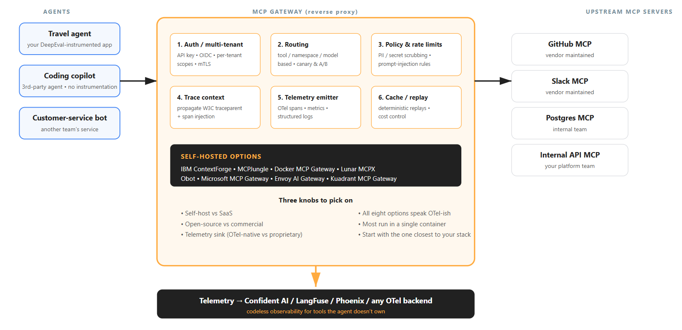
Layer 4: Context Layer Trace
Benefits beyond context tracing
D A T A H A C K S U M M I T 2 0 2 6

Slide 31
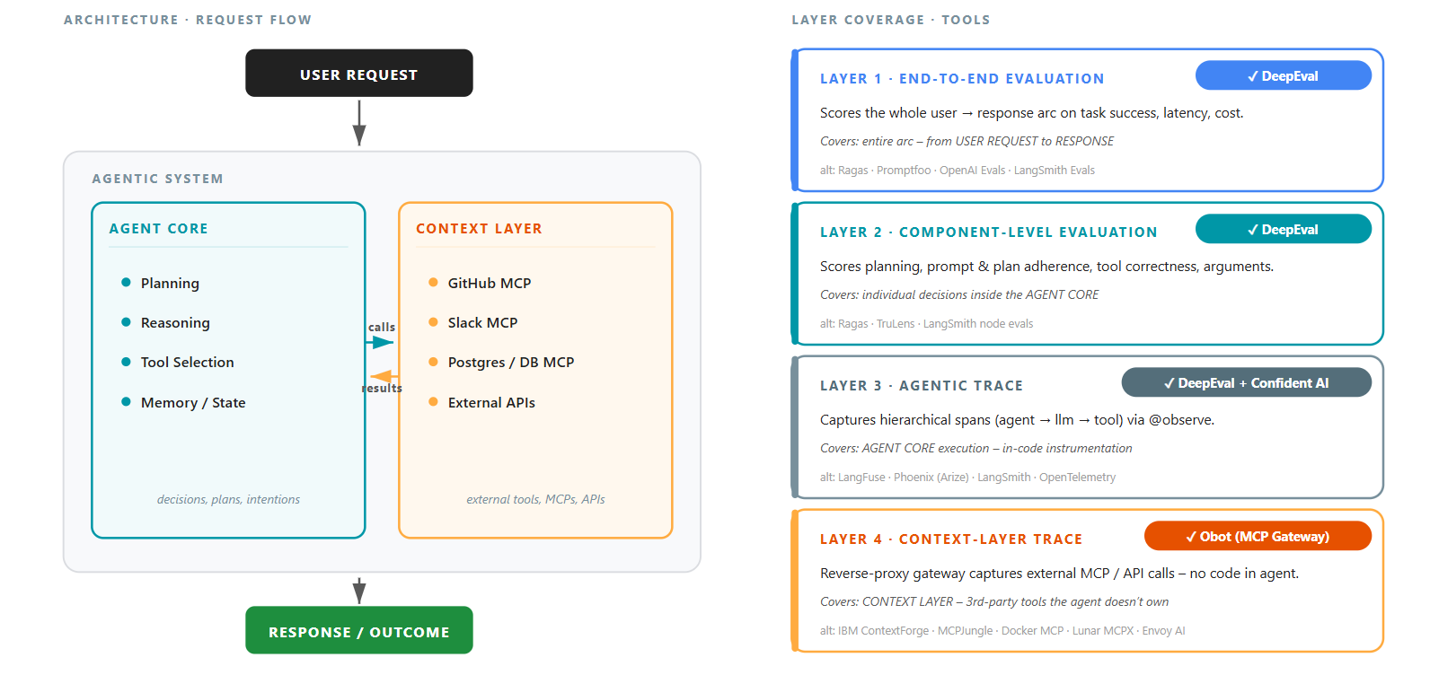
AOE Blueprint
D A T A H A C K S U M M I T 2 0 2 6

Slide 32
03
DEMO
The Framework in Action
A live walkthrough with a sample example
August 05–08, 2026 · The Leela Bhartiya City, Bengaluru
Human × AI

Slide 33
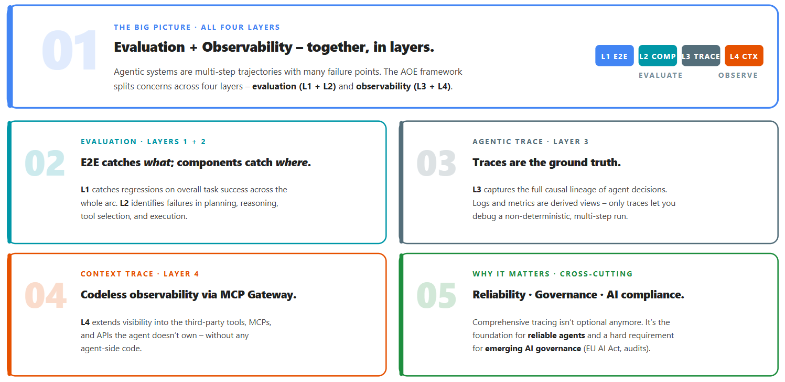
Key takeaways
D A T A H A C K S U M M I T 2 0 2 6

Slide 34
“
Questions
August 05–08, 2026 · The Leela Bhartiya City, Bengaluru
Human ×AI

Slide 35
Thank You
August 05–08, 2026 · The Leela Bhartiya City, Bengaluru
Human ×AI

